Slide 1
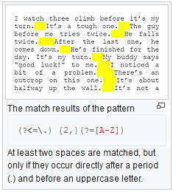
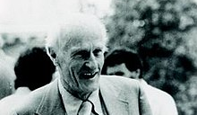
NLP Illustrated
Technique #1: Regular Expressions
Example
Pattern
…………………………Woodchuck……………………………………………………………
…………………………………………......Corpus…………………………………….
/[wW].*odchuck/
[Regular expression search requires a pattern that we want to search for, and a corpus of texts to search through. A regular expression search function will search through the corpus returning all texts that contain the pattern.] Jurafsky et.al.
Common Applications
Data Validation Validate user inputs on online forms. | Data Scraping Search webpages for particular HTML tag structure | Data Wrangling Transform raw data into suitable forms
Simple Parsing Parse simple special domain languages | Syntax Highlighting Better programming experience with code being highlighted
Kleene introduced regular expressions and gave some of their algebraic laws

